Slide 1
Updates
Olivier Bergeron

Slide 2

Others
Journal club presentation

Slide 3
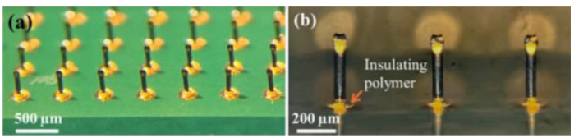
Electrodes process
COPL
Still waiting for an answer
Follow up mail sent
University of Calgary
Interested to sent us a sample
Need to decide what sample I want (WIP)

Slide 4
Impedance test bench
Still doing iterations
Overestimate PETG rigidity at low thickness
Might have question for Jonathan regarding 3D printing parameters

Slide 5
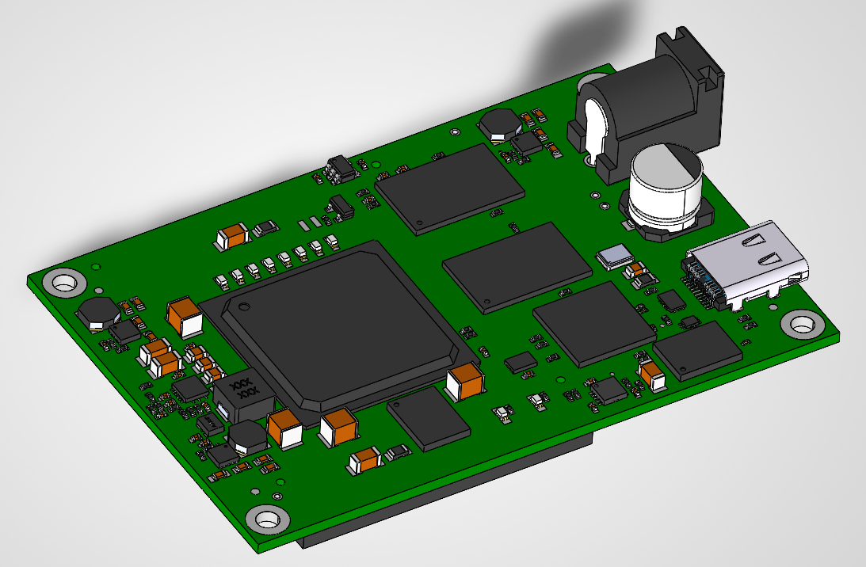
FPGA Devkit
Started the breakout PCB (WIP)
Some questions for David-Alexandre
Test the code provided by INTAN
Need the devkit to work

Slide 6
What’s next
In order:
Prepare the sample for University of Calgary
Continue with test bench
Breakout board design

